Slide 1
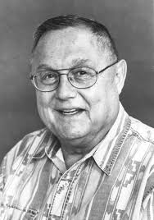
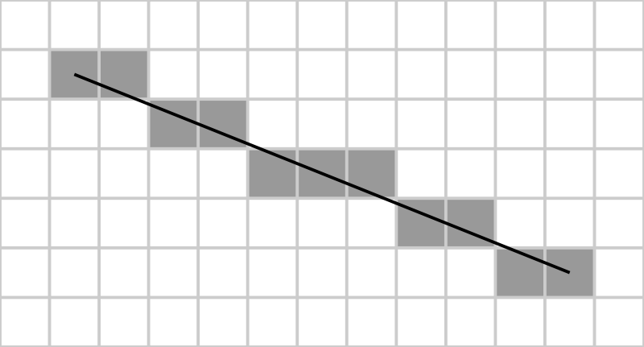
ST0275 Computer Graphics
EAFIT

Slide 2
Agenda
Motivation
Come up with your solution
Bresenham’s algorithm (1965)

Slide 3
Motivation
Line segments are a very important part of every graphics package
We will see the challenges that arise when moving from continuous- to discrete-spaces.

Slide 4
Drawing line segments
Starting with:
Coordinates of a starting point P1(x₁, y₁)
Coordinates of an ending point P2(x₂, y₂)
Routine to draw a pixel setPixel(x, y)
Write the psudo-code to draw a line of pixels from P1 to P2.

Slide 5
Drawing line segments
What issues need to be considered?

Slide 6
Typical solution
1st octant (0 <= m <= 1)
dx = x2 – x1; dy = y2 – y1;
steps = dx; yIncrement = dy / dx;
x = x1; y = y1;
setPixel(x, y);
for (k = 1; k <= steps; k++) {
x = x + 1; y = y + yIncrement;
setPixel(x, round(y));
}

Slide 7
Bresenham’s algorithm
Works only with integers.
Is faster than the typical solution.
We will start with the first octant (0 <= m <= 1).

Slide 8
Bresenham’s line algorithm
For each x_{k}, the corresponding y is chosen based on the following graph:
If d₁ is smaller than d₂, y_{k} is chosen; otherwise y_{k} + 1 is chosen.
y_{k}+1
d₂
y
d₁
y_{k}
x_{k}+1

Slide 9
Bresenham’s line algorithm
We are interested on the sign of d₁ – d₂.
At the pixel for x_{k}:
If d₁ – d₂ > 0, y_{k}+1 is chosen
If d₁ – d₂ < 0, y_{k} is chosen

Slide 10
Bresenham’s line algorithm
Start with the line equation:
y = m(x_{k} + 1) + b
Then
d₁ = y – y_{k} = m(x_{k}+1) + b - y_{k}
and
d₂ = (y_{k}+1) – y = y_{k} + 1 – m(x_{k}+1) – b
so
d₁-d₂=2m(x_{k}+1)-2y_{k}+2b-1 (i)
Remember we are interested on the sign of d₁-d₂

Slide 11
Bresenham’s line algorithm
In order to make everything integer, we substitute
m = Δy/Δx (Δy =y₂-y₁ and Δx = x₂-x₁).
Then we define
p_{k} = Δx(d₁-d₂) => d₁-d₂= p_{k}/Δx
Because it will have the same sign as d₁-d₂
Substitute in (i) (and multiply both sides by Δx):
p_{k} = 2 (x_{k}+1)Δy - 2y_{k}Δx + 2bΔx - Δx
Or
p_{k} = 2x_{k}Δy + 2Δy - 2y_{k}Δx + 2bΔx - Δx (0)
We separate the terms that do not involve x_{k} nor y_{k}:
c = 2Δy + Δx(2b – 1)
And we get…

Slide 12
Bresenham’s line algorithm
And we get:
p_{k} = 2x_{k}Δy – 2y_{k}Δx + c (1)
Now, we can compute p_{k+1} based on p_{k} as follows:
p_{k+1}=2x_{k+1}Δy – 2y_{k+1}Δx + c (2)
Subtracting (2) from (1) we get
p_{k+1} – p_{k} = 2(x_{k+1}-x_{k}) Δy – 2(y_{k+1}-y_{k}) Δx
p_{k+1} – p_{k} = 2 Δy – 2(y_{k+1}-y_{k}) Δx (3)
where the term y_{k+1} – y_{k} depends on the sign of p_{k} (It will be either 0 or 1).

Slide 13
Bresenham’s line algorithm
This recursive calculation of decision parameters is performed at each integer x position.
To make things simpler, we move the origin to x₁, y₁ (x₁ = 0, y₁ = 0, b = 0), and equation (0) becomes:
p₀ = 2Δy – Δx
And this is the first decision parameter

Slide 14
Bresehnam’s line algorithm
Input the line end points.
Plot x₀, y₀
Calculate constants Δx, Δy, 2Δy and 2Δy-2Δx.
Compute the first decision parameter:
p₀ = 2Δy – Δx
At each x_{k}, along the line, perform the following test:
If p_{k}<0, the next point to plot is (x_{k}+1, y_{k}) and p_{k+1} = p_{k} + 2Δy (see eq. (3)).
Otherwise, the next point to plot is (x_{k}+1, y_{k}+1) and p_{k+1} = p_{k} + 2Δy – 2Δx (see eq. (3)).
Repeat the previous step Δx times.

Slide 15
Bresenham’s line algorithm
incE = 2 * dy;
incNE = 2 * dy - 2 * dx;
d = 2 * dy - dx;
y = y1;
for (x = x1; x <= x2; x++) {
putpixel(x, y);
if (d <= 0) {
d += incE;
} else {
d += incNE;
y += 1;
}
}

Slide 16
Bresenham’s line algorithm
This algorithm works for the first octant only (why?)
How to develop similar algorithms for the other octants?
Reading: Hearn&Baker, Sect 3.5.
Orignal Paper: Jack E. Bresenham, "Algorithm for computer control of a digital plotter", IBM Systems Journal, Vol. 4, No.1, January 1965, pp. 25–30

Slide 17
Bresenham’s line algorithm
Short (and elegant) implementations:
http://en.wikipedia.org/wiki/Bresenham's_line_algorithm
https://rosettacode.org/wiki/Bitmap/Bresenham%27s_line_algorithm#Java
Imagen de Jack Elton Bresenham: http://www-inst.eecs.berkeley.edu/~cs150/sp13/agenda/lec/lec12-video.pdf

